Slide 1
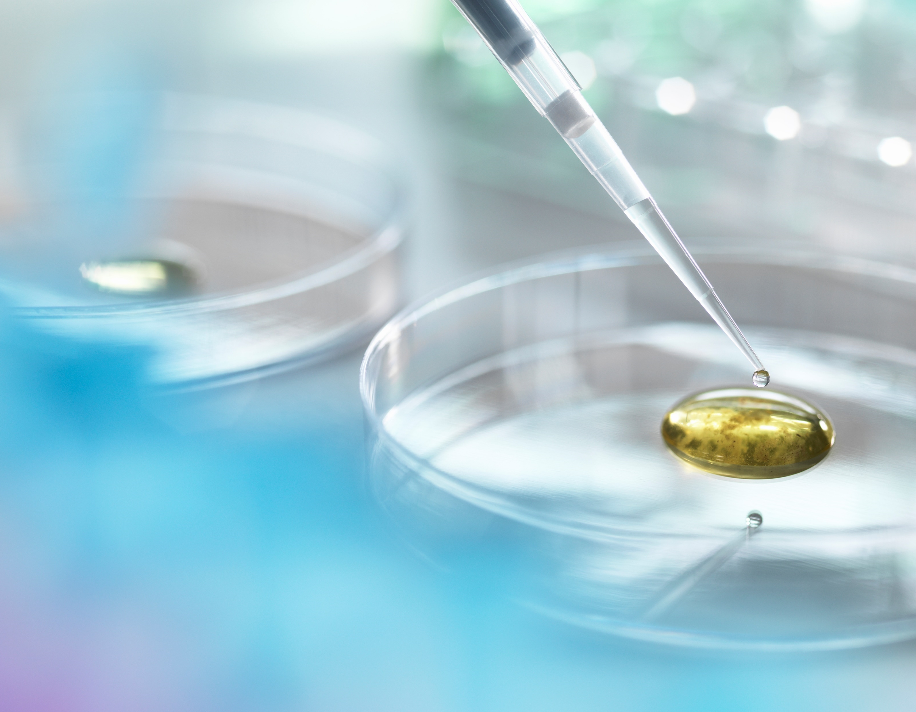
Data 606 Final Project Presentation
By: Mubashira Qari

Slide 2
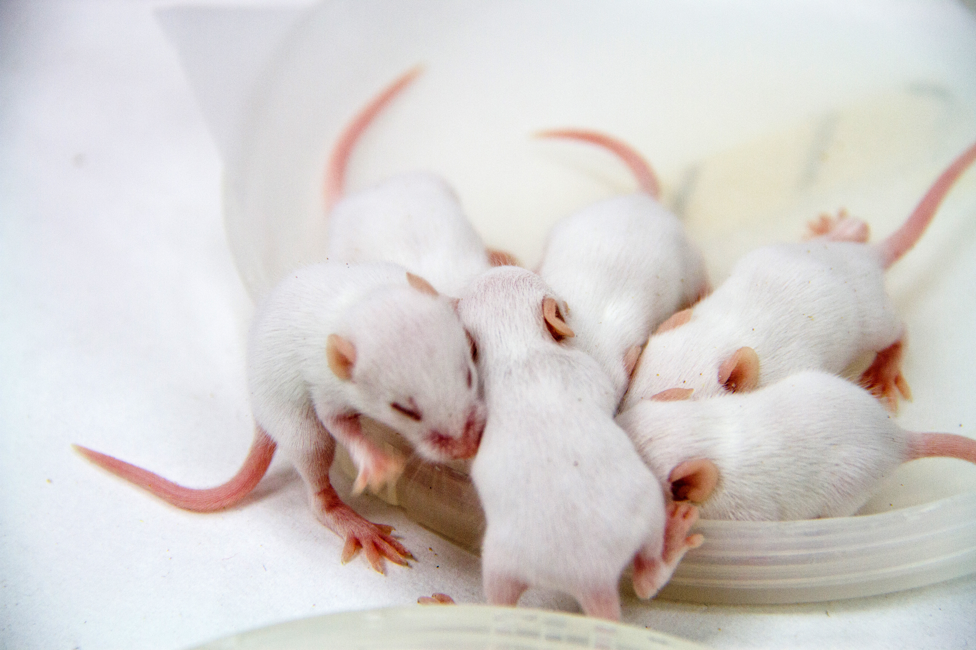
Overview:
Pymaceuticals Inc., a fictional pharmaceutical company specializes in drug-based, anti-cancer pharmaceuticals. They have provided the data to test the efficacy of potential drug treatments for squamous cell carcinoma. In this study, 249 mice identified with Squamous cell carcinoma (SCC) tumor growth, kind of skin cancer, were treated through a variety of drug regimens. Over the course of 45 days, tumor development was observed and measured. The objective is to analyze the data to show how four treatments (Capomulin, Infubinol, Ketapril, and Placebo) compare.
Notes:
This is an experimental study where a group of 249 mice were monitored after administrating a variety of drug regimens over a 45-day treatment period. The impact of Capomulin drug on tumor growth, and survival rates were monitored, along with Infubinol, Ketapril, and Placebo.

Slide 3
dependent variable (what is being measured)
The response variable is the size of tumor, "Tumor.Volume..mm3.“measured in cubic millimeter and it holds a numerical data.

Slide 4
Data Collection
The datasets are provided by Pymaceuticals Inc.. Below is the link for the original source of the datasets:
https://c-l-nguyen.github.io/web-design-challenge/index.html
The raw datasets are imported from the GitHub links provided below:
https://raw.githubusercontent.com/rfpoulos/pymaceuticals/master/data/Mouse_metadata.csv
https://raw.githubusercontent.com/rfpoulos/pymaceuticals/master/data/Study_results.csv

Slide 5
independent variable:
The explanatory variable is the "Drug.Regimen" and it holds a categorical data and "Timepoint" which holds numerical data. The 'Timepoint' unit is 'days'..

Slide 6
Data Collection
The datasets are provided by Pymaceuticals Inc.. Below is the link for the original source of the datasets:
https://c-l-nguyen.github.io/web-design-challenge/index.html
The raw datasets are imported from the GitHub links provided below:
https://raw.githubusercontent.com/rfpoulos/pymaceuticals/master/data/Mouse_metadata.csv
https://raw.githubusercontent.com/rfpoulos/pymaceuticals/master/data/Study_results.csv

Slide 7
Research Question
Question 1: Is Capomulin more effective than the three other drugs in the dataset?
Question 2: Is there a correlation between the age, weight and the effectiveness of capomulin?
Null Hypothesis: There is no difference between the effectiveness of the four drug regimens.
Alternate Hypothesis: Capomulin is more effective than the other three drug regimens on treating SCC tumor growth.

Slide 8
Data Breakdown
Number of cases : The metadata contain 249 unique mouse id.
There are 10 different drug treatments.
The total sample size of mouse is 100.
Four drug treatments: Capomulin, Infubinol, Ketapril, and Placebo.
The sample size of mouse by drug treatments is 25 each.

